Slide 1
Memory Management Memory Abstraction Address Space

Slide 2
Review
Memory Manager
coordinate how the different types of memory are used
keep track memory to allocate and release areas of main memory to processes
manage swapping between main memory and disk
No Memory Abstractions
Single program
One OS, only one process
Special register is used to protection between OS and process
Disadvantages: slow
Multiple program:
Divided into fixed size block
Disadvantages
Internal fragmentations (phân mảnh)
Two programs both reference absolute physical memory → static relocation

Slide 3
Objectives
A Memory Abstraction
Address Space
Base and Limit Registers
Swapping
Memory Management with Bitmaps
Memory Management with Linked Lists
Virtual Memory
Problems

Slide 4
A Memory Abstraction
Address space
Is the abstraction that is referenced to the set of addresses a process (không gian địa chỉ trừu tượng )
Is the set of addresses that a process can use to address memory
Is decoupled from the physical memory (larger or smaller)
Is a very general concept and occurs in many contexts
Do not have to be numeric (ex: .com Internet domain)

Slide 5
A Memory Abstraction
Base and Limit Registers
Issues
Multiple programs (processes)
To ensure correct operation in order to protect the operating system from access by user processes and to protect user processes from one another
Each process has a range of legal addresses.
Process can access only these legal addresses
Improve static relocation
Solution
Give a two supplementary registers into the hardware
Base register: hold the physical address where the program begins in memory.
Limit register: specify the length of program
When the process is allocated in the memory
The base register is loaded the physical address where the program begins
The limit register is loaded the length of process
The address of process is relative (that is not compiled)
Every time, a process references memory,
The CPU hardware automatically adds the base register’s value to the address generated by the process to generate the real address
Simultaneously, it checks if the address offered is equal to or greater than the value in the limit register, in which case a fault is generated and the access is aborted

Slide 6
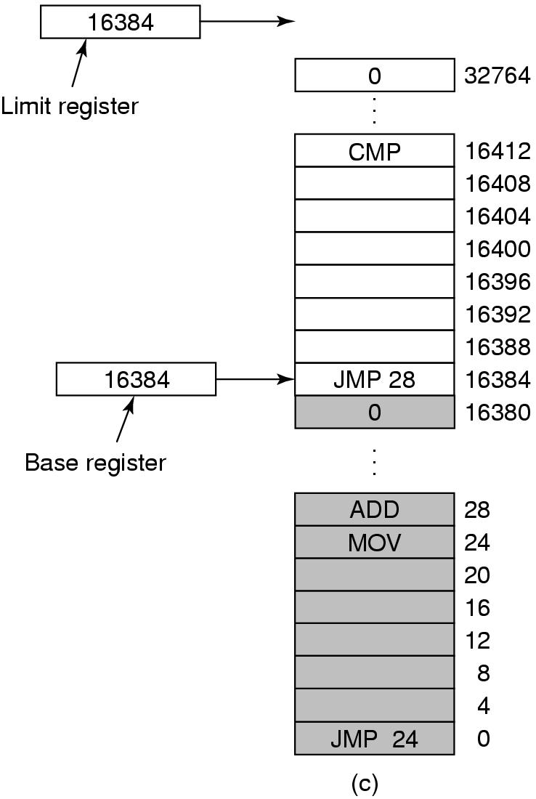
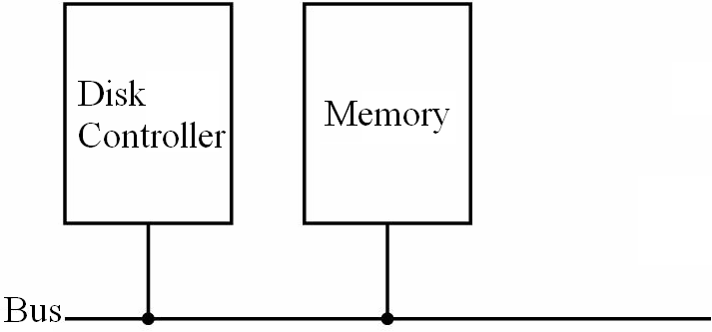
A Memory Abstraction
Base and Limit Registers
Limit Register
Base Register
True
Relative address
<
+
False
Real address
Address error; trap/ interrupt
Tanenbaum, Fig. 3-3.
Notes:
Relative : địa chỉ tương đối.

Slide 7
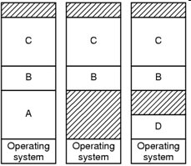
A Memory Abstraction
Base and Limit Registers
This solution is an easy way to give each process its own private address space.
Advantages
The process can move to new location in the memory at runtime
When it moves, the base register’s value is reloaded
Disadvantages
Need perform an addition and a comparison on every memory reference (update the registers’ value when the location of memory changes)
External Fragmentation → compacting
Notes:
Fragmentation: có 2 dạng phân mảnh( Internal và External)

Slide 8
A Memory Abstraction
Swapping
The reason
No more space in memory to keep all the active processes
Keeping all processes in memory all the time requires a huge amount of memory and cannot be done if there is insufficient memory
The simplest strategy is swapping
Bringing in each process in its entirely, running it for a while, then putting it back on the disk
Operation
swap out (memory → HDD)
swap in (memory ← HDD)
At one moment, a process is entirely in the memory to be run or entirely on the HDD

Slide 9
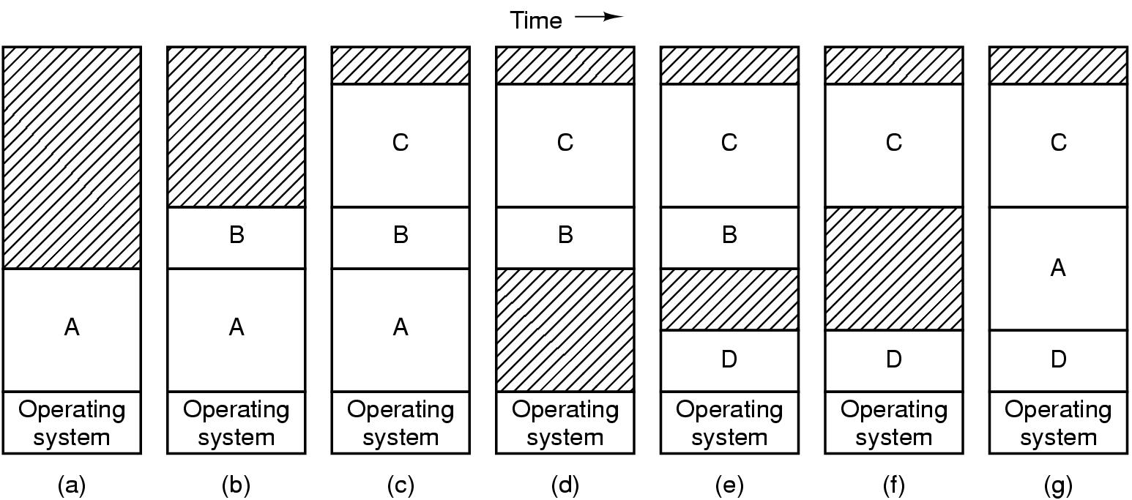
A Memory Abstraction
Swapping
Tanenbaum, Fig. 3-4.

Slide 10
A Memory Abstraction
Swapping
Memory compaction technique (external defragment/ compaction)
When swapping creates multiple holes in memory, it is possible to combine all into one big one by moving all the processes downward as far as possible
Disadvantages: slow and complexity (the addresses are changed and updated)
If processes are created with fixed size that never changes, the OS allocates exactly what is needed
Problem: the processes’ data segments can grow →
If the process is adjacent to another process, the growing process will either have to be moved to a hole on memory large enough for it, or one or more processes will have to be swapped out to create a large enough hole
If a process can not grow in memory and the swap area on the disk is full, the process will have to suspended until some space is freed up (or it can be killed)

Slide 11
A Memory Abstraction
Swapping
Solutions
Allocate a little extra memory (!?) whenever a process is swapped in or moved
Others
Each process has a stack of top of its allocated memory that is growing downward, and
A data segment just beyond the program text that is growing upward
The memory between them can be used for either segment.
If it runs out, the process will either have to be moved to a hole with sufficient space swapped out of memory until a large enough hole can be created, or killed

Slide 12
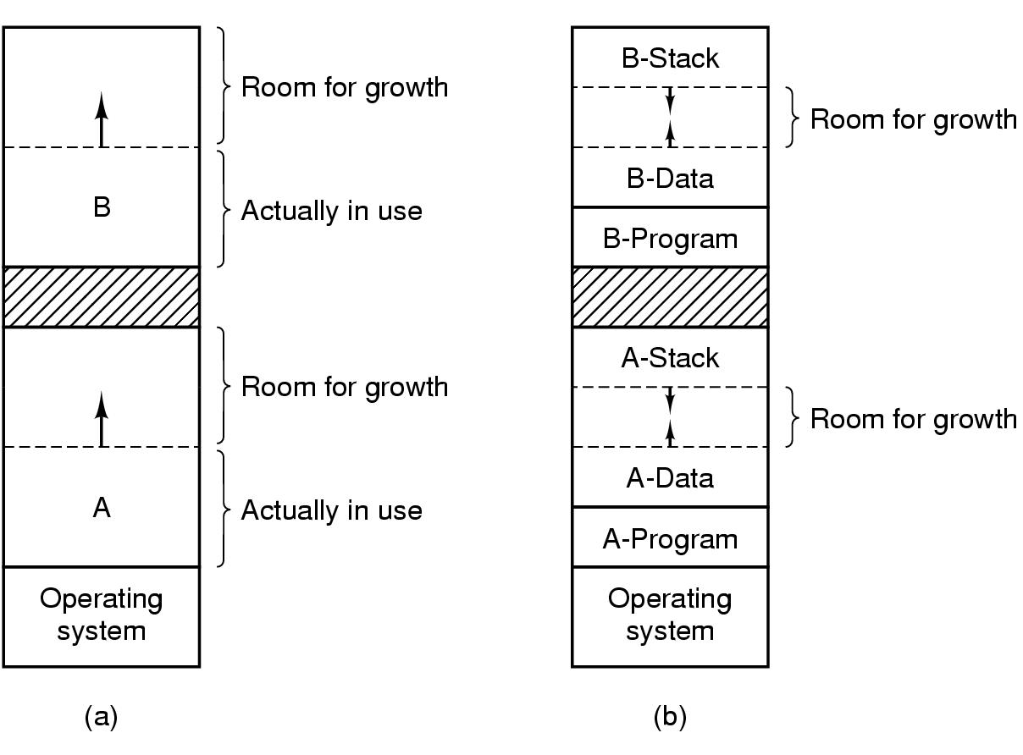
A Memory Abstraction Swapping
Tanenbaum, Fig. 3-5.

Slide 13
A Memory Abstraction Memory Management with Bitmaps
The memory is divided up into allocation units of the same size
Each allocation unit has a bit corresponding bit in the bitmap
0 → the unit is free
1 → the unit is occupied
The size of the allocation unit is an important design issue
The smaller the size, the greater the bitmap
The greater the size, the smaller the bitmap, but results in waste of memory (internal fragmentation)
A Bitmap provides a simple way to keep track memory words in a fixed amount of memory because the size of the bitmap depends only on the size of memory and the allocation units

Slide 14
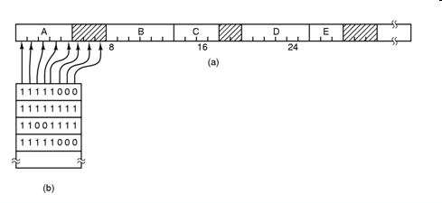
A Memory Abstraction Memory Management with Bitmaps
Tanenbaum, Fig. 3-6.
Problem: when it has been decided to bring a k unit process into memory, the memory manager must search the bitmap to find a run of k consecutive 0 bits in the map → slow

Slide 15
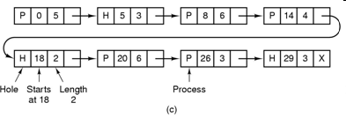
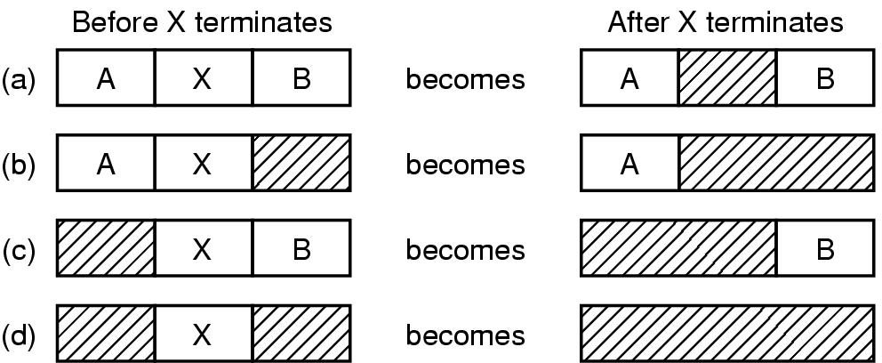
A Memory Abstraction Memory Management with Linked Lists
Maintain a linked list of allocated and free memory segments, where a segment either contains a process or is an empty hole between two processes, to keep track of memory
Each entry in the list specifies
a hole (H) or process (P)
the address at which its starts
The length
The pointer to the next entry
List sorted by the memory address
updating the list is simple and fast
Tanenbaum, Fig. 3-6.
Tanenbaum, Fig. 3-7.

Slide 16
A Memory Abstraction Memory Management with Linked Lists
Allocation of memory
First fit – fast
The memory manager scans along the list of segments until it finds a hole that a big enough
The hold is then broken up into pieces, one for the process and one for the unused memory
Next fit – slightly worse performance than first fit
Works same as first fit except that it keep tracks of where it is whenever it finds a suitable hole
The next time it is called to find a hole, it starts searching the list from the place where it left off last time, instead of always at the beginning
Best fit – slower; tends to fill up memory with tiny, useless holes
Search the entire list, from beginning to end, and takes the smallest hole that is adequate
Rather than breaking up a big hole that might be needed later, best fit tries to find a hole that is close to the actual size needed, to best match the request and the available holes
Worst fit – is not a very good idea
Take a largest available hole, so that the new hole will be big enough to be useful
Notes:
First-fit: quét đến khi tìm thấy lỗ đủ trống để xài
Next-fit (cấp vùng nhớ rồi tìm tiếp) kém hiệu quả hơn First-fit vì tìm giữ thông tin để tìm tiếp
Best-fit: tìm hết và lấy hole nhỏ nhất
Worst-fit: tìm lỗ lớn nhất ( not good idea)

Slide 17
A Memory Abstraction Memory Management with Linked Lists
8K
8K
12K
First Fit
12K
22K
Best Fit
6K
Last
allocated
block (14K)
18K
2K
Memory direct access
8K
8K
6K
6K
Allocated block
Free block
14K
14K
Next Fit
36K
20K
Before
After
Allocate to block (16K) using First Fit, Best Fit, or Next Fit

Slide 18
A Memory Abstraction Memory Management with Linked Lists
Separate lists for processes and holes
Speed up searching for a hole at allocation
Complicates releasing of memory (additional complexity and slowdown because a freed segment has to be removed from the process list and inserted into the hole list)
Holes list can be sorted by the size (to make best fit faster same as first fit)
A small optimization is possible. Instead of having a separate set of data structures maintaining the hole list, the information can be stored in the holes (the first word hold hole size, the second word a pointer to the following entry)
Quick fit
Finding a hole of the required size is extremely fast, but it has the same disadvantage as all schemes that sort by hole size, namely, when process terminates or is swapped out, finding its neighbors to see if a merge is possible expensive
If merging is not done, memory quickly fragment into a large number of small holes into which no processes fits
Notes:
-Quick fit (tìm hole cực kỳ lớn)

Slide 19
Virtual Memory Problems
Managing bloat ware
While memory sizes are increasing rapidly, software sizes are increasing much faster
There is need to run programs that are too large to fit in memory, and there is certainly a need to have a systems that can support multiple programs run simultaneously
Swapping is not an attractive option (SATA disk)
Solutions
Keep in memory only the program of instructions and data (a part of program, not entire program) that are needed at any given time
When other instructions are needed, they are loaded into space occupied previously by instructions that are no longer needed
The overlays and paging are proposed

Slide 20
Virtual Memory Overlays
The developer must manually split programs into little pieces
The overlays were kept on the disk and swapped in and out of memory by overlay manager
When a program started,
First, the overlay manager (overlay 0) is loaded into the memory
Then, the overlay 0 is informed to load the little pieces (overlay 1) into memory either above overlay 0 in memory (if there was space for it) or on top overlay 0 (if there was no space)
When the overlay 1 finished, the overlay 0 is informed to load the overlay 2 into memory either above overlay 1 in memory (if there was space for it) or on top overlay 0 (if there was no space), and so on
The all code of overlays are kept on disk as absolute memory images, and are read by the overlay0 as needed. Special relocation and linking algorithms are needed to construct the overlays
Advantages
Do not require any special support from the OS
Disadvantages
The developers must burden the knowledge of the structure of program, its code, the size of pieces (overlays) that are split

Slide 21
Virtual Memory Overlays
Example
The program is partition such as assembler into pass 1 code (70KB), pass 2 code (80KB), and the symbol table (20KB) and common routines (30KB) used by both pass 1 and pass 2.
The memory has only 150 KB. The overlay0 has its size as 10KB
→ It is impossible to load everything of program into memory because the required program size is 200KB
Therefore, the overlays is applied to overlay1 with 120KB (pass 1, symbol table, and common routines) and the overlay2 with 130KB (pass 2, symbol table, and common routines)
First, the overlay0 is loaded into memory. Then, overlay1 is also loaded above the overlay 0
When the overlay1 has finished, the control return the overlay0 that reads overlay2 into memory, overwriting overlay1, and transfer control to overlay2

Slide 22
Summary
A Memory Abstraction
Problems overview of Virtual Memory
Q&A

Slide 23
Next Lecture
Virtual Memory

